Slide 1
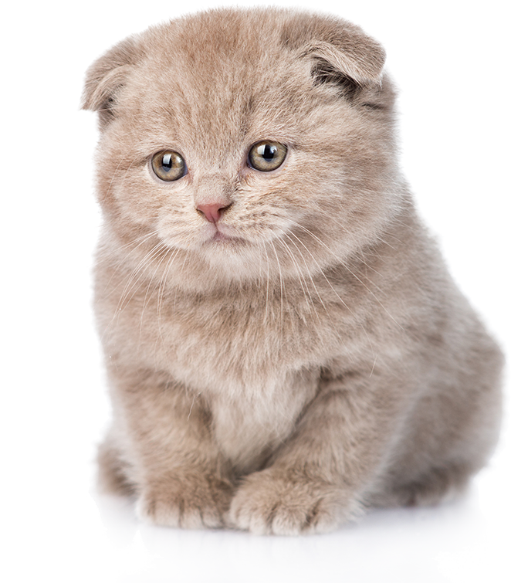
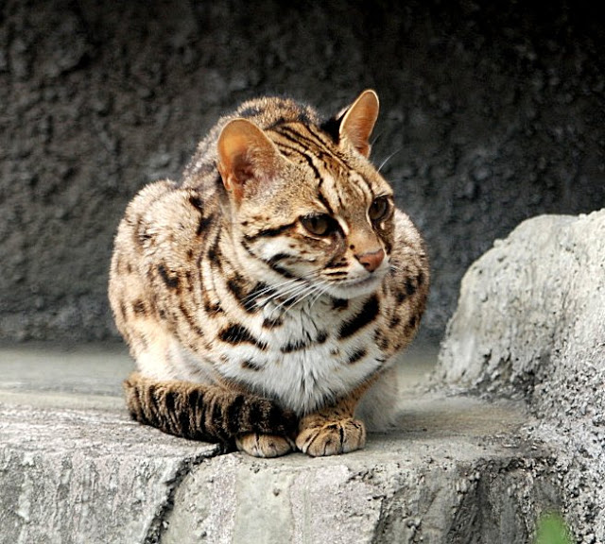
 | MèScottish Fold Scottish Fold
Scottish Fold
 | Felis bengalensis
Felis bengalensis

Slide 2
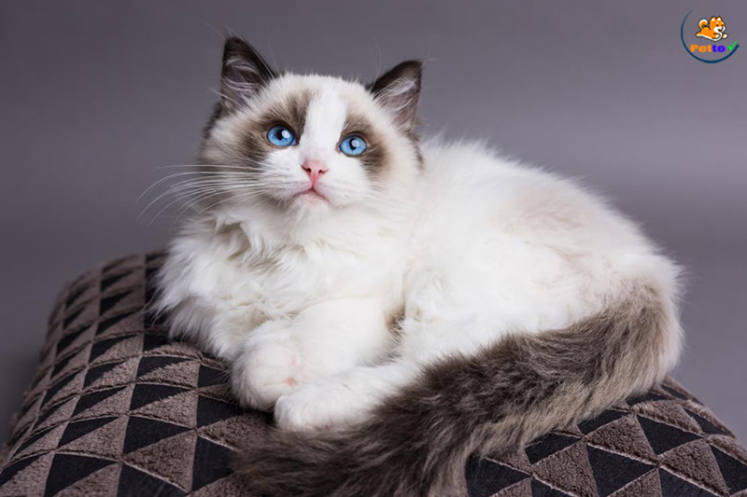
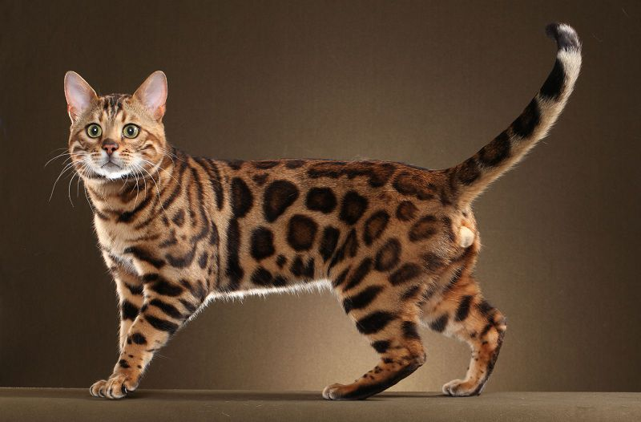
 | Ragdoll Scottish Fold
Ragdoll
 | Bengal
Bengal

Slide 3
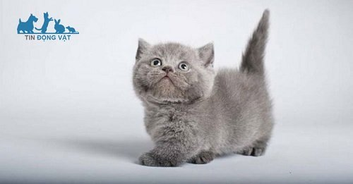
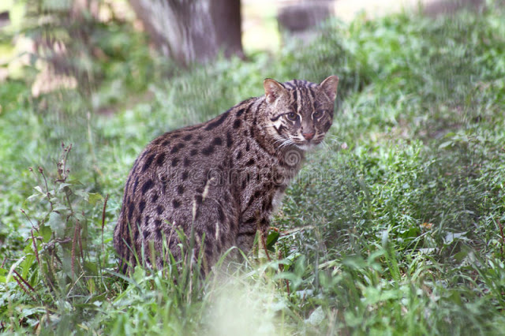
 | èMunchkin Scottish Fold
Munchkin
 | Felis viverrina
Felis viverrina

Slide 4
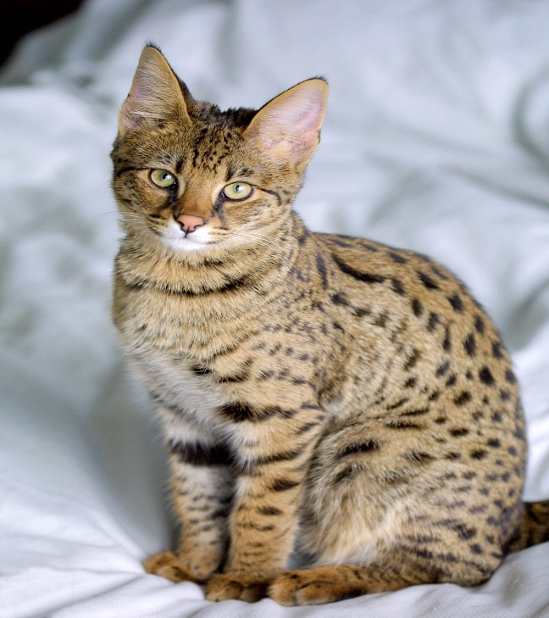
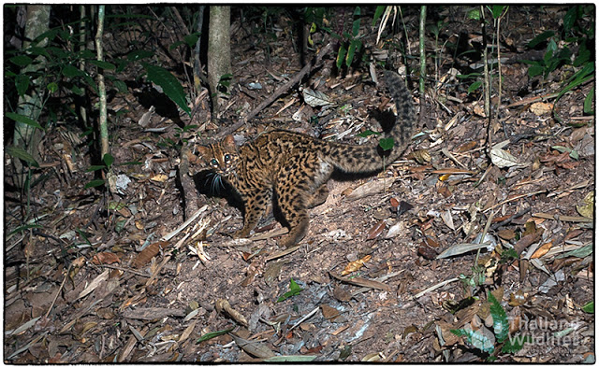
 | MSavannah Scottish Fold
Savannah
 | Pardofelis marmorata
Pardofelis marmorata

Slide 5
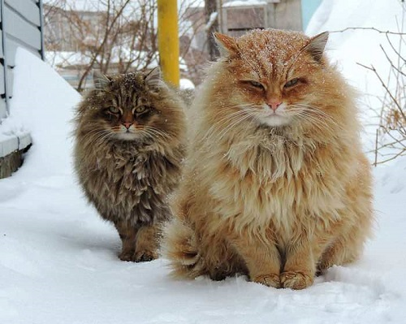
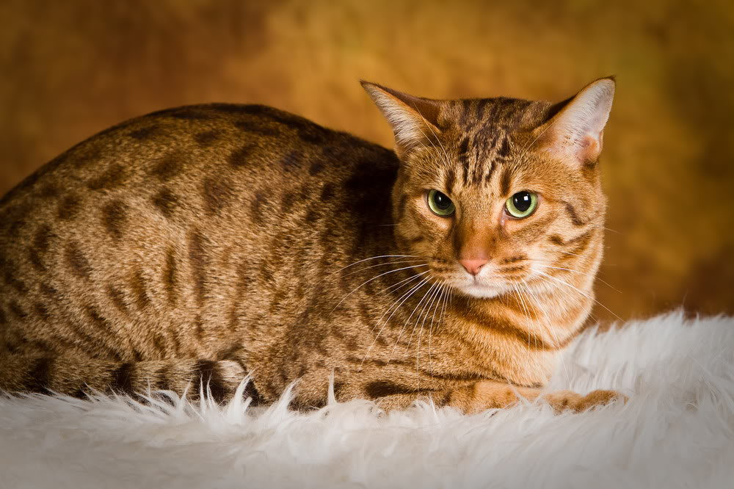
 | M Siberia Scottish Fold
Siberia
 | Ocicat
Ocicat

Slide 6
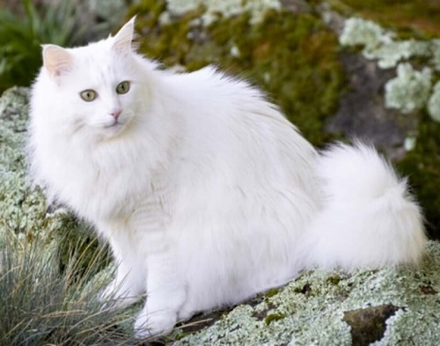
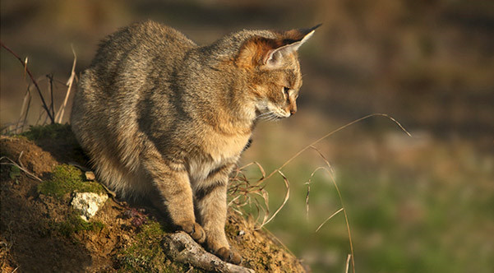
 | Mè Angora Scottish Fold
Angora
 | Felis chaus
Felis chaus

Slide 7
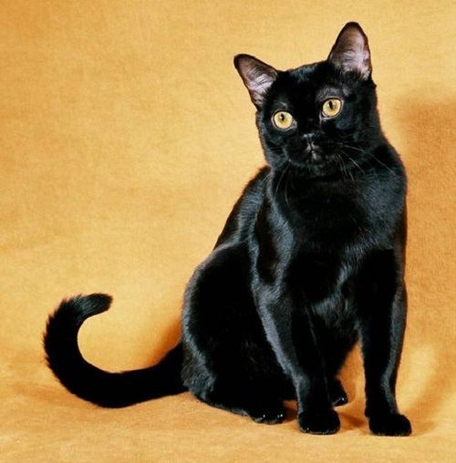
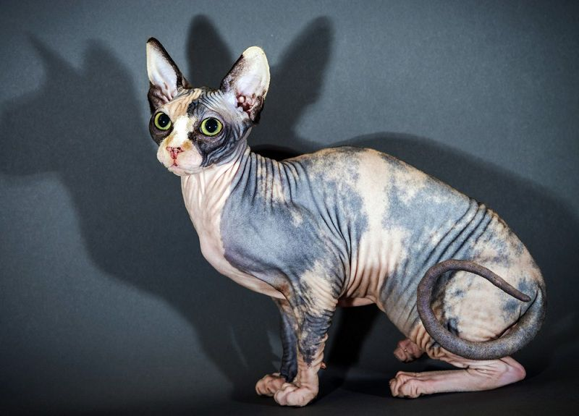
 | M Bombay Scottish Fold
Bombay
 | Sphynx
Sphynx

Slide 8
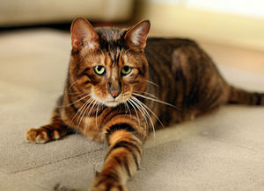
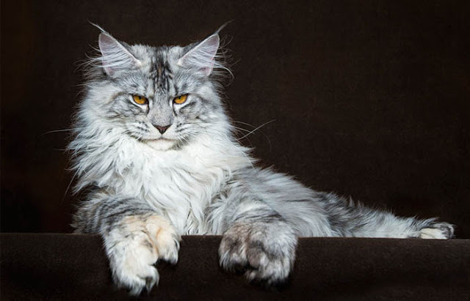
 | Mè Toyger Scottish Fold
Toyger
 | Manie Coon
Manie Coon

Slide 9
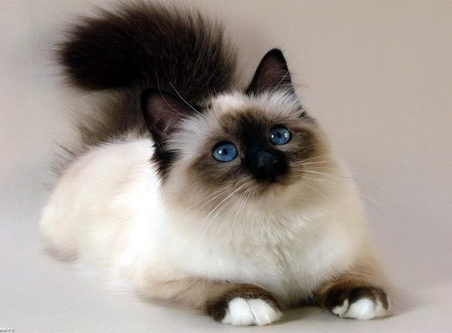
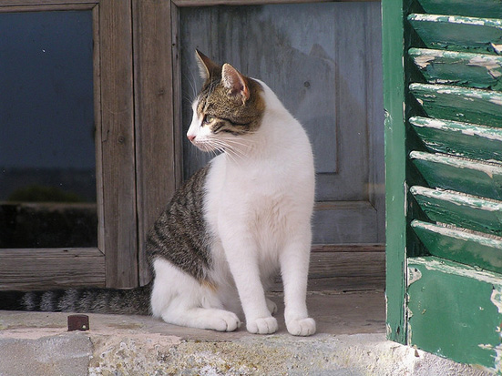
 | MBalinese Scottish Fold
Balinese
 | Felis domestica
Felis domestica

Slide 10
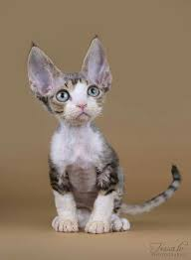
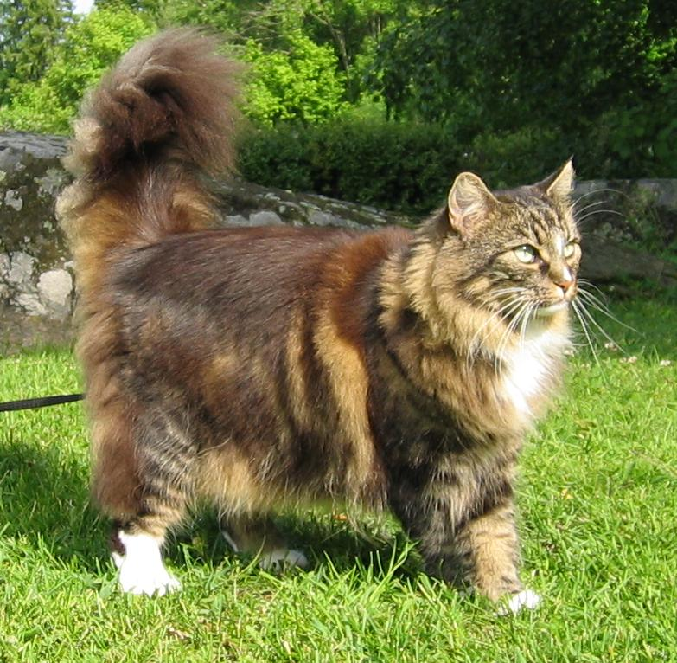
 | Devon Rex Scottish Fold
Devon Rex
 | Nauy
Nauy

Slide 11
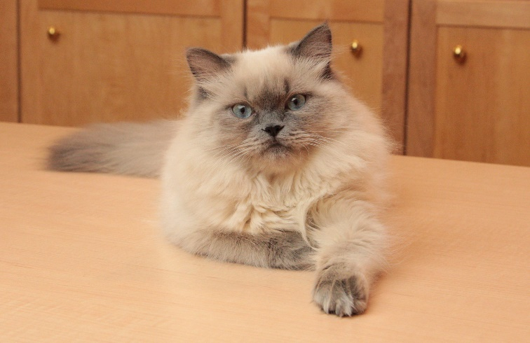
 | Mè Toyger Scottish Fold
Toyger
 | Himalaya
Himalaya

Slide 12
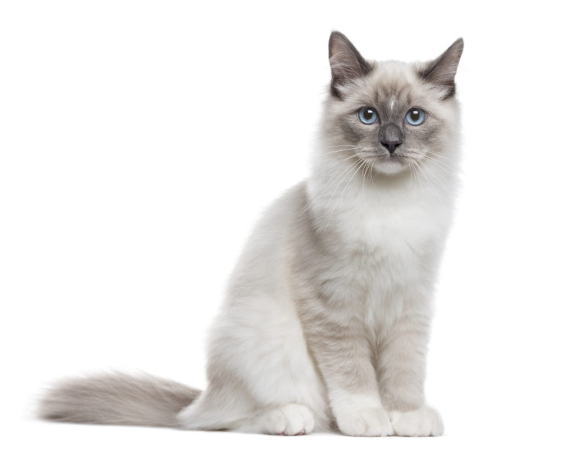
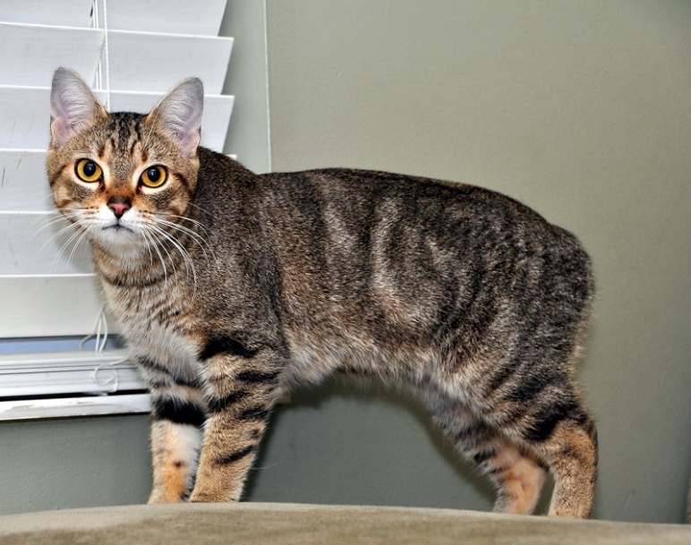
 | Neva Masquerade Scottish Fold
Neva Masquerade
 | Manx
Manx

Slide 13
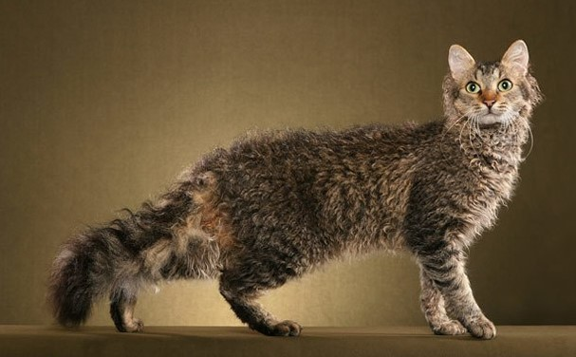
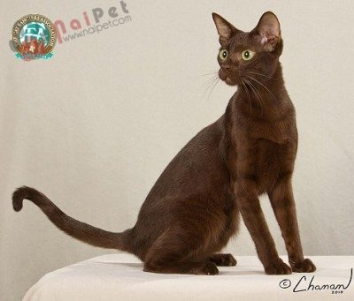
 | LaPerm Scottish Fold
LaPerm
 | Havana Brown
Havana Brown

